Slide 1
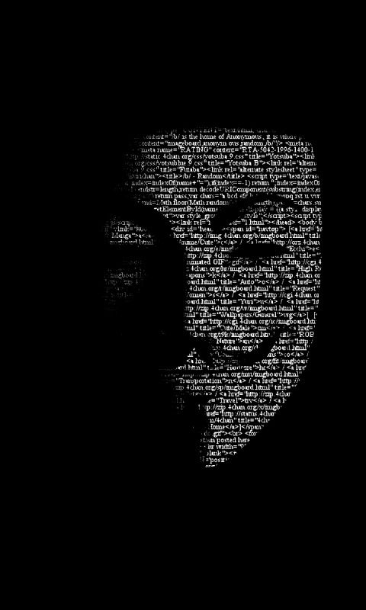

SHRI RAM COLLEGE OF ENGINEERING AND MANAGEMENT, PALWAL
DEPARTMENT OF COMPUTER SCIENCE ENGINEERING
PRESENTATION ON
“CYBER CRIME”
PRESENTED BY
Name: KISHAN
Roll No.: 181007

Slide 2


CONTENTS
INTRODUCTION ABOUT CYBER CRIME
CYBER CRIME VARIANTS
RANKING OF INDIA IN CYBER CRIME
COST OF CYBER CRIME IN INDIA
CYBER LAWS IN INDIA
INFORMATION TECHNOLOGY AMENDMENT ACT,2008
ARRESTS AND REPORTS UNDER IT ACT
ARRESTS AND REPORTS UNDER IPC
HOW TO TACKLE SUCH ACTIVITES?
CONCLUSION

Slide 3


CYBER CRIME
The expression ‘Crime’ is defined as an act, which subjects the doer to legal punishment or against morality, social order or any unjust or shameful act.
Cyber crime involves use of computer as an instrument to further illegal ends, such as committing fraud, stealing identities, or violating privacy.
Cyber Crime is emerging as a serious threat. World wide governments, police departments and intelligence units have started to react.

Slide 4
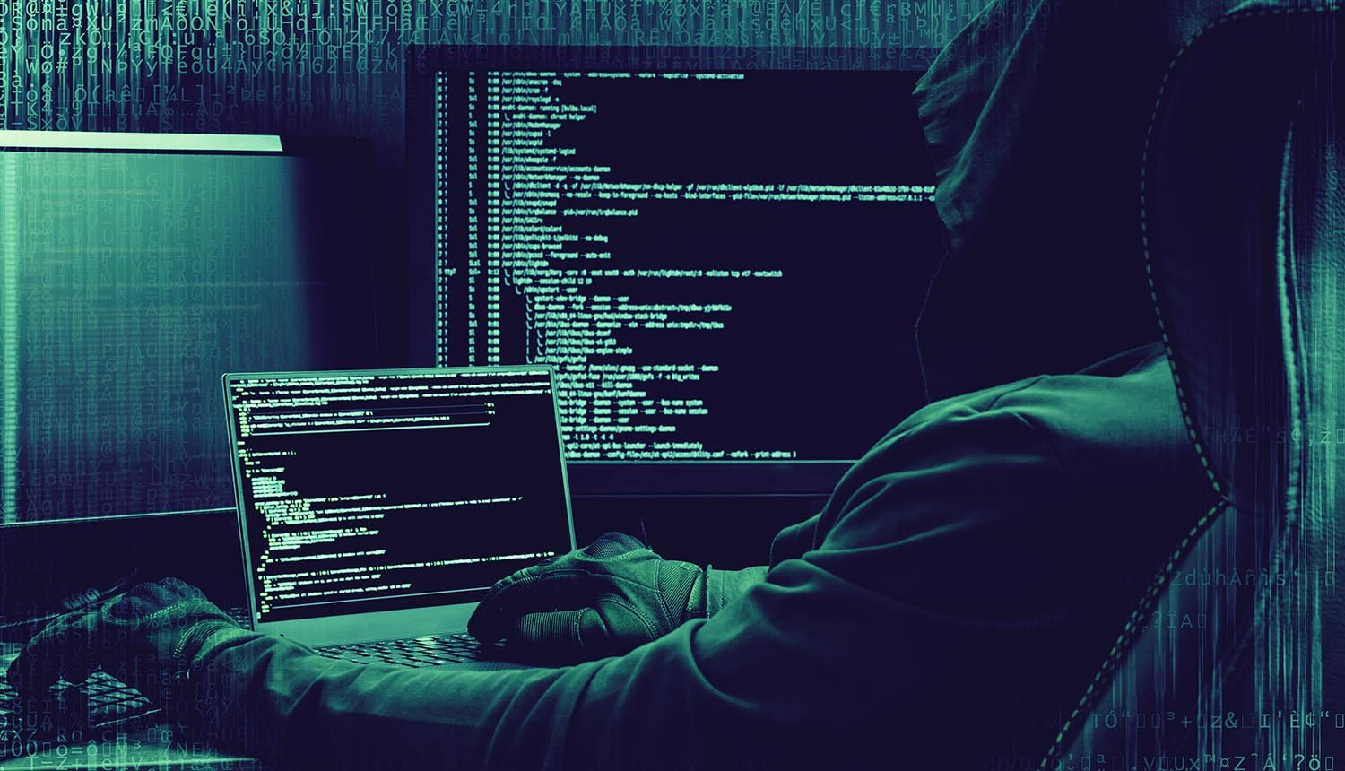


CYBER CRIME VARIANTS
Hacking:
"Hacking" is a crime, which entails cracking systems and gaining unauthorized access to the data stored in them. Hacking had witnessed a 37per cent increase this year.
Cyber Squatting:
Cyber Squatting is the act of registering a famous Domain Name and then selling it for a fortune. This is an issue that has not been tackled in IT ACT 2000.

Slide 5


PHISHING:
Phishing is just one of the many frauds on the Internet, trying to fool people into parting with their money. Phishing refers to the receipt of unsolicited emails by customers of Financial Institutions, requesting them to enter their User name, Password or other personal information to access their Account for some reason. The fraudster then has access to the customers online bank account and to the funds contained in that account.

Slide 6
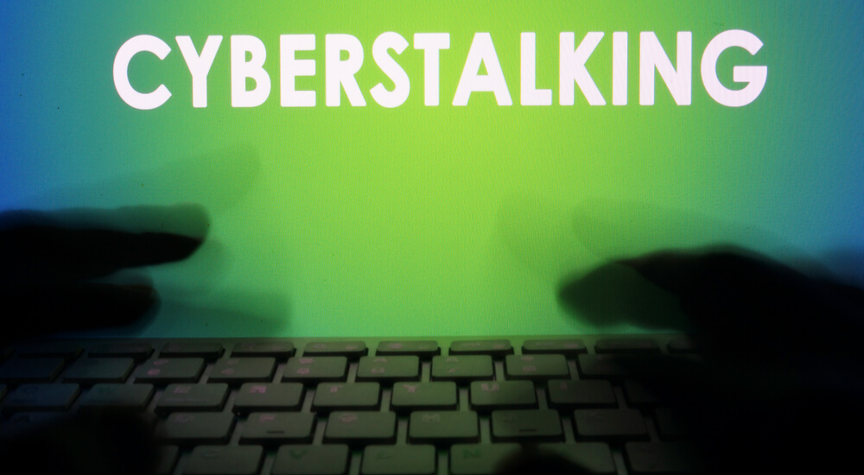

Cyber Stalking is use of the Internet or other electronic means to stalk someone. This term is used interchangeably with online harassment and online abuse. Stalking generally involves harassing or threatening behavior that an individual engages in repeatedly, such as following a person, appearing at a persons home or place of business, making harassing phone calls, leaving written messages or objects, or vandalizing a persons property.

Slide 7
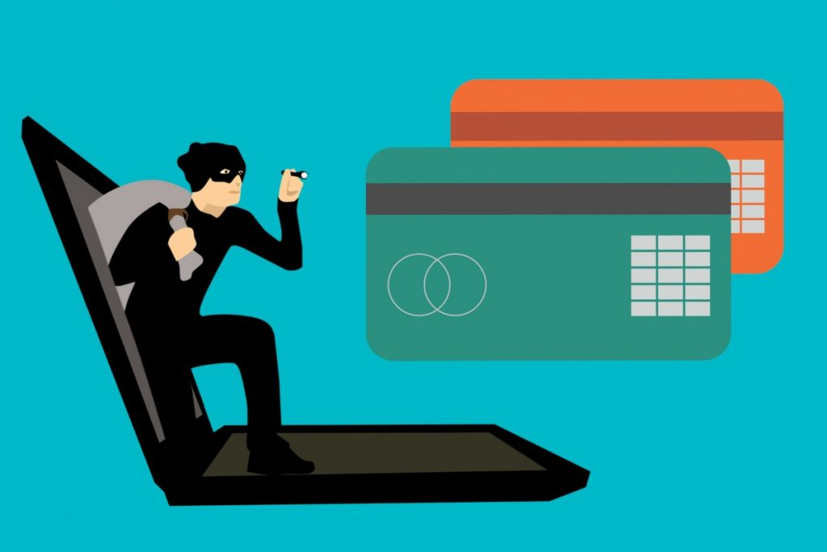
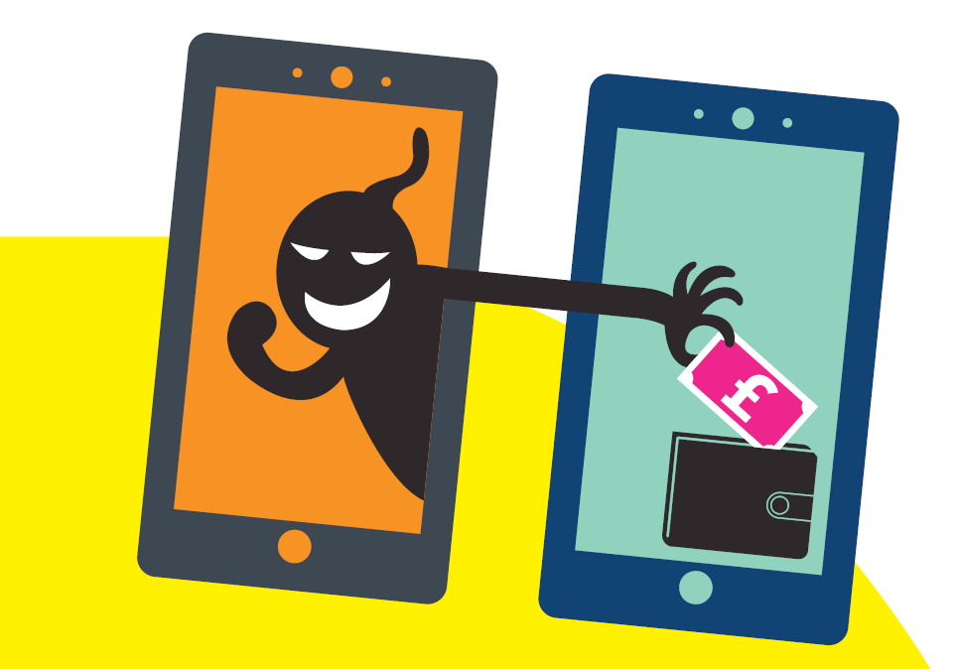
VISHING:
Vishing is the criminal practice of using social engineering and Voice over IP (VoIP) to gain access to private personal and financial information from the public for the purpose of financial reward. The term is a combination of “Voice" and phishing. Vishing exploits the publics trust in landline telephone services. Vishing is typically used to steal credit card numbers or other information used in identity theft schemes from individuals.

Slide 8
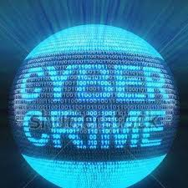
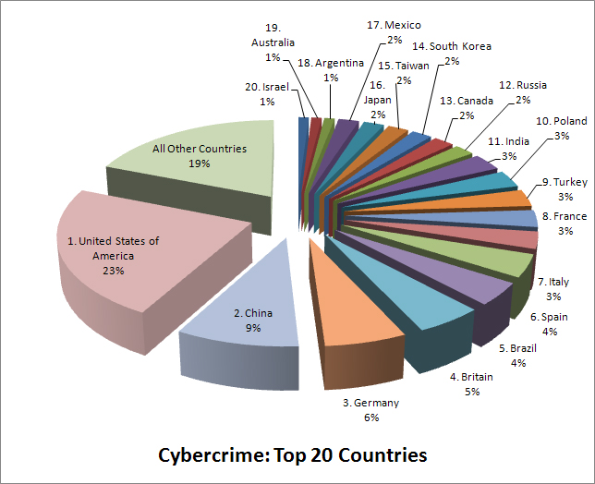
India stands 11th in the ranking for Cyber Crime in the World, constituting 3%of the Global Cyber Crime.

Slide 9


COST OF CYBER CRIME IN INDIA
29.9 million people fell victim to cybercrime.
$4 billion in direct financial losses.
$3.6 billion in time spent resolving the crime.
4 in 5 online adults (80%) have been a victim of Cybercrime.
17% of adults online have experienced cybercrime on their mobile phone.

Slide 10

CYBER LAWS IN INDIA
Under The Information Technology Act, 2000
CHAPTER XI – OFFENCES – 66. Hacking with computer system.
Whoever with the Intent to cause or knowing that he is likely to cause Wrongful Loss or Damage to the public or any person Destroys or Deletes or Alters any Information Residing in a Computer Resource or diminishes its value or utility or affects it injuriously by any means , commits hack.
Whoever commits hacking shall be punished with imprisonment up to three years, or with fine which may extend up to two lakh rupees, or with both.

Slide 11

INFORMATION TECHNOLOGY AMENDMENT ACT, 2008
SECTION-43
“If any person, dishonestly, or fraudulently, does any act referred to in section 43, he shall be punishable with imprisonment for a term which may extend to two to three years or with fine which may extend to five lakh rupees or with both.”

Slide 12

SECTION 66C- PUNISHMENT FOR IDENTITY THEFT
“Whoever, fraudulently or dishonestly make use of the electronic signature, password or any other unique identification feature of any other person, shall be punished with imprisonment of either description for a term which may extend to three years and shall also be liable to fine which may extend to rupees one lakh.”
SECTION 66D - PUNISHMENT FOR CHEATING BY PERSONATION BY USING COMPUTER RESOURCE
“Whoever, by means of any communication device or computer resource cheats by personation, shall be punished with imprisonment of either description for a term which may extend to three years and shall also be liable to fine which may extend to one lakh rupees. ”

Slide 13

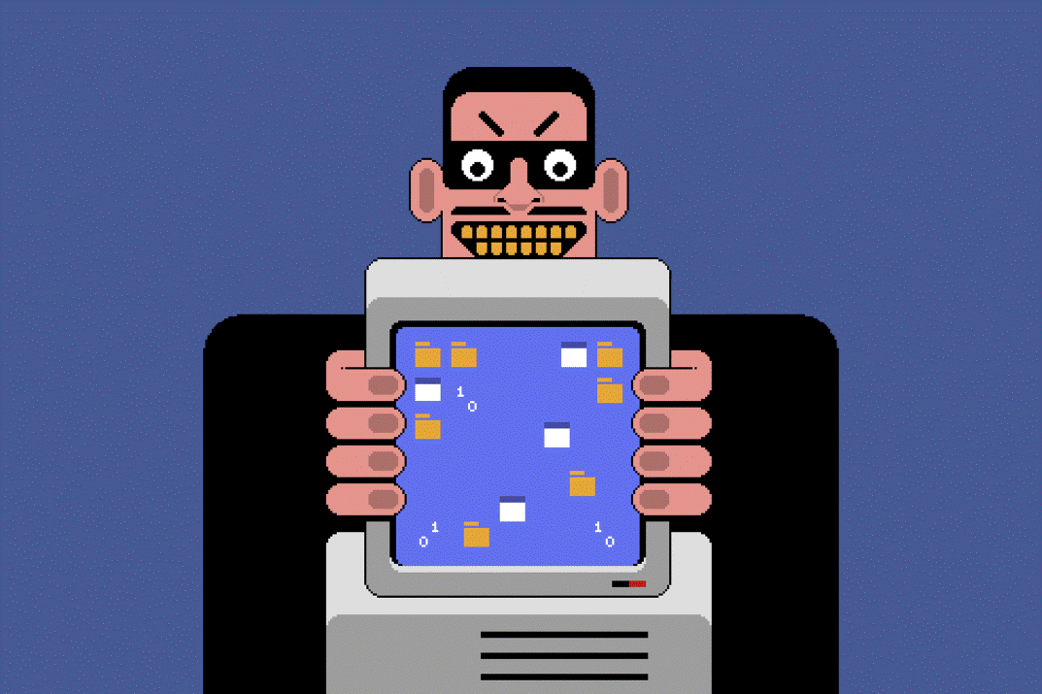
SECTION 66 E- PUNISHMENT FOR VIOLATION OF PRIVACY-
“Whoever , intentionally or knowingly captures , publishes or transmits the image of a private area of any person without his or her consent , under circumstances violating the privacy of that person , shall be punished with imprisonment which may extend to three years or with fine not exceeding two lakh rupees , or with both.

Slide 14

ARRESTS AND REPORTS UNDER IT ACT
Under the IT Act, 966 cybercrime cases were filed in 2019 420 in 2018
Geographic breakdown of cases reported:
o 153 from Karnataka,
o 148 from Kerala
o 142 from Maharashtra
o 105 from Andhra Pradesh
o 52 from Rajasthan
o 52 from Punjab
233 persons were arrested
33% of the cases registered were related to hacking
Source: National Crime Records Bureau

Slide 15

ARRESTS AND REPORTS UNDER IPC
Under the IPC, 356 cybercrime cases were registered in 2019 (276 cases in 2018)
Geographic breakdown of cases reported –
o 104 from Maharashtra
o 66 Andhra Pradesh
o 46 Chhattisgarh
The majority of these crimes were either forgery or fraud cases.
Source: National Crime Records Bureau

Slide 16
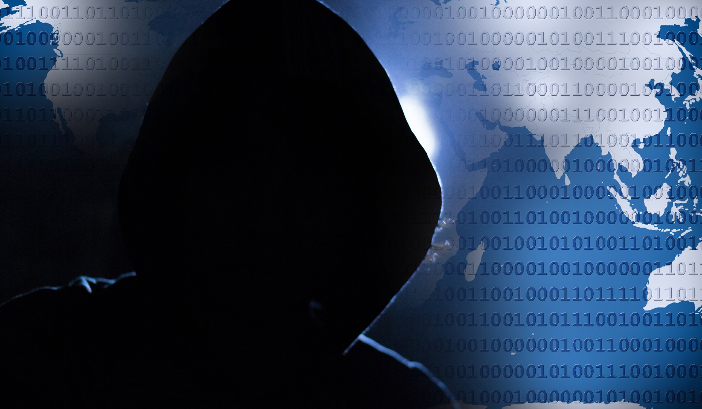
HOW TO TACKLE SUCH ACTIVITIES
An important question arises that how can these crimes be prevented. A number of techniques and solutions have been presented but the problems still exists and are increasing day by day .
Antivirus And Anti Spyware Software:
Antivirus software consists of computer programs that attempt to identify, thwart and eliminate computer viruses and other malicious software. Anti spywares are used to restrict backdoor program, Trojans and other spy wares to be installed on the computer.
Firewalls:
A firewall protects a computer network from unauthorized access. Network firewalls may be hardware devices, software programs, or a combination of the two. A network firewall typically guards an internal computer network against malicious access from outside the network.

Slide 17
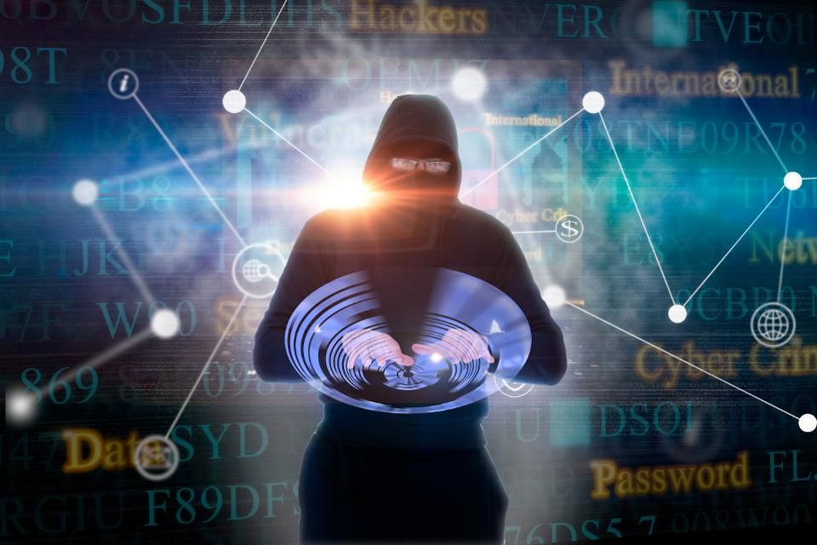
FUTURE OF CYBER CRIME IN INDIA
Continued Website Hacks and Defacements
Data and Information theft
Increasing Phishing attacks on Ecommerce and Financial Websites
Cybercriminals targeting Social and Professional Networks
Threats Directed at the Mobile Platform:
Smartphones and Tablets

Slide 18

CONCLUSION
“Indian Laws are well drafted and are capable of handling all kinds of challenges as posed by cyber criminals. However, the enforcement agencies are required to be well versed with the changing technologies and Laws”. "As internet technology advances so does the threat of cyber crime . In times like these we must protect ourselves from cyber crime. Anti-virus software, firewalls and security patches are just the beginning. Never open suspicious e-mails and only navigate to trusted sites.”

Slide 19
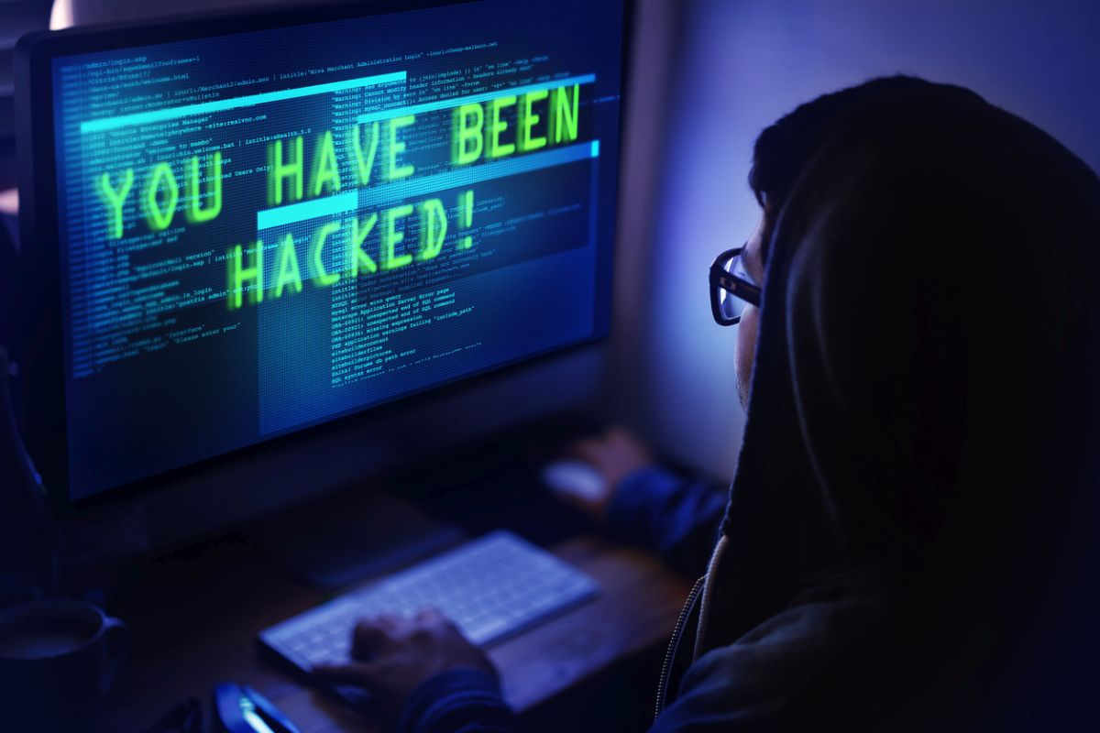
THANK YOU ALL!

